Slide 1


HOTEL MANAGEMENT SOFTWARE
Can Tho University
PROJECT CHARTER
Presented by Group 2

Slide 2
CORE MEMBERS
Can Tho University
INTRODUCTION
STT | NAME | POSITION | STUDENT INFORMATION
1 | Trương Đặng Trúc Lâm | Project Leader | Student ID: B2111933, Class: DI21V7F3 Course 47 of Information Technology (high quality program)
2 | Đặng Hoàng Hưng | Project Member | Student ID: B2111984, Class: DI21V7F3 Course 47 of Information Technology (high quality program)
3 | Lê Xuân Thành | Project Member | Student ID: B2111952, Class: DI21V7F1 Course 47 of Information Technology (high quality program)
4 | Nguyễn Duy Bằng | Project Member | Student ID: B2111971, Class: DI21V7F3 Course 47 of Information Technology (high quality program)
HMS (Hotel Management Software) is a comprehensive solution that streamlines the operations and administration of hospitality business. This software offers a centralized platform to manage all aspects of your hotel business, from reservations and check-ins to accounting and financial management.

Slide 3
INTRODUCTION
OUR DESIRE AND ESTIMATION
Can Tho University
HMS (Hotel Management Software) is a comprehensive solution that streamlines the operations and administration of hospitality business. This software offers a centralized platform to manage all aspects of your hotel business, from reservations and check-ins to accounting and financial management.
General Objectives | The project provides friendly management functions for the users such as data updating, maintaining, and searching. The management system helps the users carry out the various activities which are relevant to hotel management faster than manual measures that they did before such as reservations, service registration, check-out.
Specific Objectives | The main objective of the activity is to automatically conduct hotel management operations day by day such as room activities, or provide an on-demand room for customers.
Duration | Duration: 20 months
Budget | Estimate cost: 1,265,346,596 VND.

Slide 4
OUR DESIRE AND ESTIMATION
Can Tho University
General Objectives | The main objective of the system conducting hotel management operations day by day such as room activities, or provide an on-demand room for customers.
Specific Objectives | The management system helps the users carry out the various activities which are relevant to hotel management faster than manual measures that they did before such as reservations, service registration, check-out. The project provides friendly management functions for the users such as data updating, maintaining, and searching.
Duration | Duration: 16 weeks
Budget | Estimate cost: 1,265,346,596 VND.

Slide 5
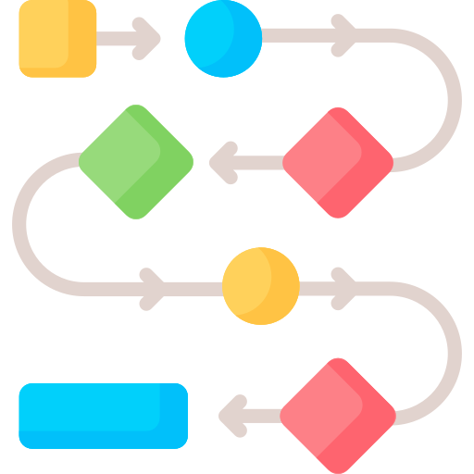


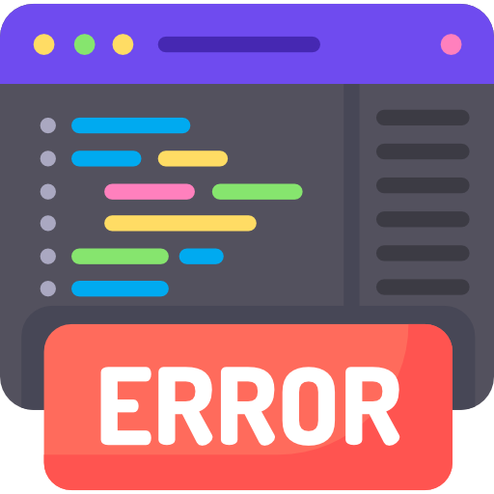

MODEL RATIONALE
Can Tho University
A lot of use-cases to handle
Require a lot of effort to conduct
Require a lot of time to manage
Data become messy if managing wrong way
Putting high pressure on staffs

Slide 6
METHODOLOGIES & TECHNOLOGIES
Can Tho University
Using SCRUM model
Methodologies:
System Development: build and deploy a hotel management software (based on Product Owner’s requirement and Developer’s ability)
System improvement: test and evaluate, then monitor the software for improvement.
Training and Maintenance: train for users (staffs) and maintain the system.
Technologies:
Using UML, Microsoft SQL and Java

Slide 7
WORKING PLAN
Can Tho University
TASK INFORMATION | DURATION
Creating SRS | 1 week
Analyzing and Developing Server for Database Storage | 1 week
Developing Human resource department’s client functions | 3 weeks
Developing Business department’s client functions | 3.5 weeks
Developing Accounting department’s client functions | 3 weeks
Developing Receptionist’s client functions | 3.5 weeks
Training for users (staffs) and maintaining the system. | 1 weeks

Slide 8
SCRUM SPRINT IN DETAIL
Can Tho University
Testers preview with Product Owner and Developers
Product Owner discuss with experts to decide needed features
SCRUM
Product Owner discuss with developers to get possibility of requirements
Developers build and deploy the new version

Slide 9
SYSTEM DEVELOPMENT AND IMPROVEMENT
Can Tho University
Server for Database Storage
Business department’s client functions
Receptionist’s client functions
SCRUM
SCRUM
SCRUM
SCRUM
SCRUM
Human resource department’s client functions
Accounting department’s client functions

Slide 10
SYSTEM MAINTAINANCE
Can Tho University
Testers preview with Product Owner and Developers
Training review
Training
SCRUM
Product Owner discuss with experts to decide needed features
Developers build and deploy the new version
Product Owner discuss with developers to get possibility of requirements

Slide 11


OUTPUT RESULT & EVALUATION CRITIERIA
Can Tho University
Output Result:
Server for Database Storage
Client for Reception Management
Client for Accounting Management
Client for Business Management
Client for Human Resource management
Evaluation Criteria:
Friendly and Convenient UI/UX
High performance and stability
Data integrity and consistency
Security guanrantee

Slide 12
FINANCIAL PLAN
Can Tho University
Order | Expense items | Equation | Value | Notation
1 | Software value | 1,4 x E x P x H | 723,468,608.8 | G
2 | General expenses | G x ratio (ratio = 65%) | 470,254,595.72 | G_{PM}
TOTAL |  | G_{PM} | 470,254,595.72 đ

Slide 13
THANK YOU FOR LISTENING
Can Tho University

